Slide 1
C++ WEEK 2 PRESENTATION -FUNCTIONS

Slide 2
FUNCTIONS
Void main()
{
Statement 1;
Statement 2;
Statement 3;
.
.
.
.
Statement n;
}
Void main()
{
Statement 1;
Statement 2; Sum1();
Statement 3;
Statement 4; Sum2();
Statement 5;
Statement 6;
}

Slide 3
Advantages
Support for modular programming
Reduction in program size.
Code duplication is avoided.
Code reusability is provided.
Functions can be called repetitively.
A set of functions can be used to form libraries.

Slide 4
Types
1.Built in functions :-
are part of compiler package.
Part of standard library made available by compiler.
Can be used in any program by including respective header file.
2. User defined functions:- Created by user or programmer.
Created as per requirement of the program.

Slide 5
User defined function
Void main()
{
Statement 1;
Statement 2; multiply();
Statement3;
;
;
Sum();
return0;
}
multiply()
{
;
}

Slide 6
Parts of a function
main function
{
function prototype declaration
function call
-------;
}
function declaratory/definition
{
------;
return statement
}

Slide 7
Function prototype
A function prototype is a declaration of a function that tells the program about the type of value returned by the function, name of function, number and type of arguments.
Syntax: Return_type function_name (parameter list/argument);
int add(int,int);
void add(void);
int add(float,int);
4 parts
Variable declaration Data_type variable_name ; int x=5;
float marks; int price;
Return type
Function name
Argument list
Terminating semicolon

Slide 8

Function call
A function must be called by its name followed by argument list enclosed in semicolon.
Syntax: function_name (parameter list/argument);
add(x,y);
add(40,60);
add(void); or add();
Note: data type not to be mentioned.
Suppose
Now to this function
int add(int,int); add(x,y);
or add(40,60);
//prototype
//function call

Slide 9
Parts of a function
main function
{
function prototype declaration function call
}
function declaratory/definition
{
return statement
}

Slide 10
Function definition
2 parts
Function header
Note: no semicolon in header
Syntax:
function_type function_name(parameter list)
{
Local variable declaration; Function body statement; Return statement;
}
Function body
Example: int add(int,int);
Z=add(x,y);
//prototype
//function call
int add(int a,int b)
{
body statement; Return(a+b);
//function definition

Slide 11
Why prototyping?????
#include<iostream.h> using namespace std;
void print();
Return_type function_name (parameter list/argument);
int main()
{
print(); return 0;
}
function_name(parameter list/argument);
void print()
{
cout<<“2 is even no.”<<endl;
function_type
function_name(parameter list)
}

Slide 12
Parts of a function
main function
{
function prototype declaration
Return_type function_name(arguments); eg: int add(int);
function call
-------;
}
function_name(actual arguments); eg: add(a);
function declaratory/definition
{
------;
return statement
}
Return_type function_name(formal arguments) eg: int add(int X);

Slide 13
Function categories
Function with no return value and no argument. void add(void);
Function with arguments passed and no return value. void add(int,int);
Function with no arguments but returns a value. int add(void);
iv) Function with arguments and returns a value. int add(int,int);
iii)

Slide 14
I. Function with no return value and no argument
void main()
{
void disp(void); //prototype
disp(); return 0;
}
//caller function
No value returned from calle to caller function
No arguments passed
from caller to calle
void disp() //calle function
{
cout<<“--------”<<endl;
}

Slide 15
ii. Function will not return any value but passes argument
#include<iostream.h> #include<conio.h> void add(int,int);
int main()
{
add(a,b);
int a,b;
cout<<“enter values of a and b”<<endl; cin>>a>>b;
add(a,b);
getch(); return 0;
}
void add(int x,int y)
{
int c; c=x+y;
cout<<“addition is”<<c;
}
a b
void add(int x,int y);

Slide 16
iii) Function with arguments and return value
main function
{
int sqr(int);
int a,ans;
cout<<“enter a number”; cin>>a;
ans=sqr(a);
cout<<“square of number is”<<ans; getch();
return 0;
}
//function prototype
//function call
int sqr(int X)
{
return(X*X);
}
//function declaratory/definition

Slide 17
iv) Function with no arguments but returns a value
int main()
{
int add(void); int z; z=add();
cout<<sum of 2 nos is”<<z;
getch(); return 0;
}
Function call add(x,y);
i.e z=add(x,y);
int add(void);
{
int a,b;
cout<<“enter 2 nos”; cin>>a>>b;
return(a+b);
}
P.P.Krishnaraj RSET

Slide 18
Pointers
Special type of variables which hold the address of another variable
i.e no values or datas are stored but it points to another variable where data is stored.
int a=100;
1)a→ name
Pointer stores this memory location, no direct value is stored.
100
→ 2)value
3)address

Slide 19
a
100
Declaration:
Data_type
*variable_name;
int a=100; int *ptr;
ptr=&a; //referencing
address 1
Intialisation:
“Address of” operator
ptr
address 1
or
int a=100; int *ptr=&a;
address 2
Pointer initialisation and declaration

Slide 20
Note: a pointer can be used to point to another pointer also i.e it can store the address of another pointer.
a
int a=100; int *ptr=&a;
int **ptr1=&ptr;
100
cout<<a; //100 cout<<*ptr;//100 cout<< **ptr1; //100
address 1
ptr
address 1
address 2
Note: pointer 1 points to address of ptr.
ptr1
address 2
address 3

Slide 21
#include<iosream.h> #include<conio.h>
int main()
{
int a=100;
int *p1; int * *p2; p1=&a; p2=&p1;
cout<<“address of a”<<&a; cout<<“address of a”<<p1;
cout<<“value of a”<< *p1; cout<<“value of a”<< * *p2; cout<<p2;
cout<< *p2; getch();
}
Chain of pointers
a
p1 p2
100
address 1
address 2
address 1
address 2
address 3
//p1 points to address of a
// p2 points to address of p1

Slide 22
When a variable is declared as reference, it becomes an alternative name for an existing variable. A variable can be declared as reference by putting ‘&’ in the declaration.
Reference variable in C++
int a=100;
Now we will use a reference variable i.e two names
for same memory location.
a
100
int a=100;
int &ref=a; //initialization and declaration
Now in program we can use either “a” or an alternative name “ref”
C=a+b; //same output C=ref+b;
0012dcD2

Slide 23
Program using reference variable
#include<iostream.h> #include<conio.h> int main()
{
int a=100; int &ref=a;
cout<<“value of a is”<<a;
cout<<“value of ref is”<<ref;
cout<<address of a is”<<&a; cout<<address of a is”<<&ref; getch();
}
100
100
0012dcD2
0012dcD2
Both “a” and “ref” are used for same memory location as alternative name

Slide 24
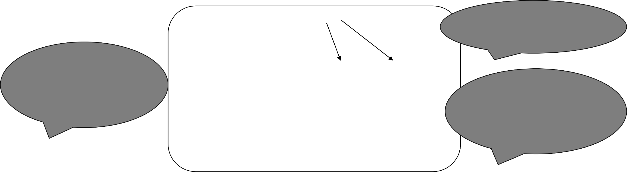
Call by value
A function can be invoked in two manners
call by value
call by reference
The call by value method copies the value of actual parameters into formal parameters i.e the function creates its own copy of arguments and uses them.
add(a,b);
Values of variables a and b are passed to X,Y
}
void add(int x,int y);
{
--------;
P.P.Kris}hnaraj RSET
Call by value where the values of variable are passed to functions
Now if you change the value of X and Y, those changes are not seen in a and b

Slide 25
/* program to illustrate the concept of call by value */
#include<iostream.h> #include<conio.h> void add(int,int);
int main()
{
int a,b;
cout<<“enter values of a and b”<<endl; cin>>a>>b;
add(a,b);
getch(); return 0;
}
void add(int x,int y)
{
int c; c=x+y;
cout<<“addition is”<<c;
P.P.Krishnaraj RSET

Slide 26
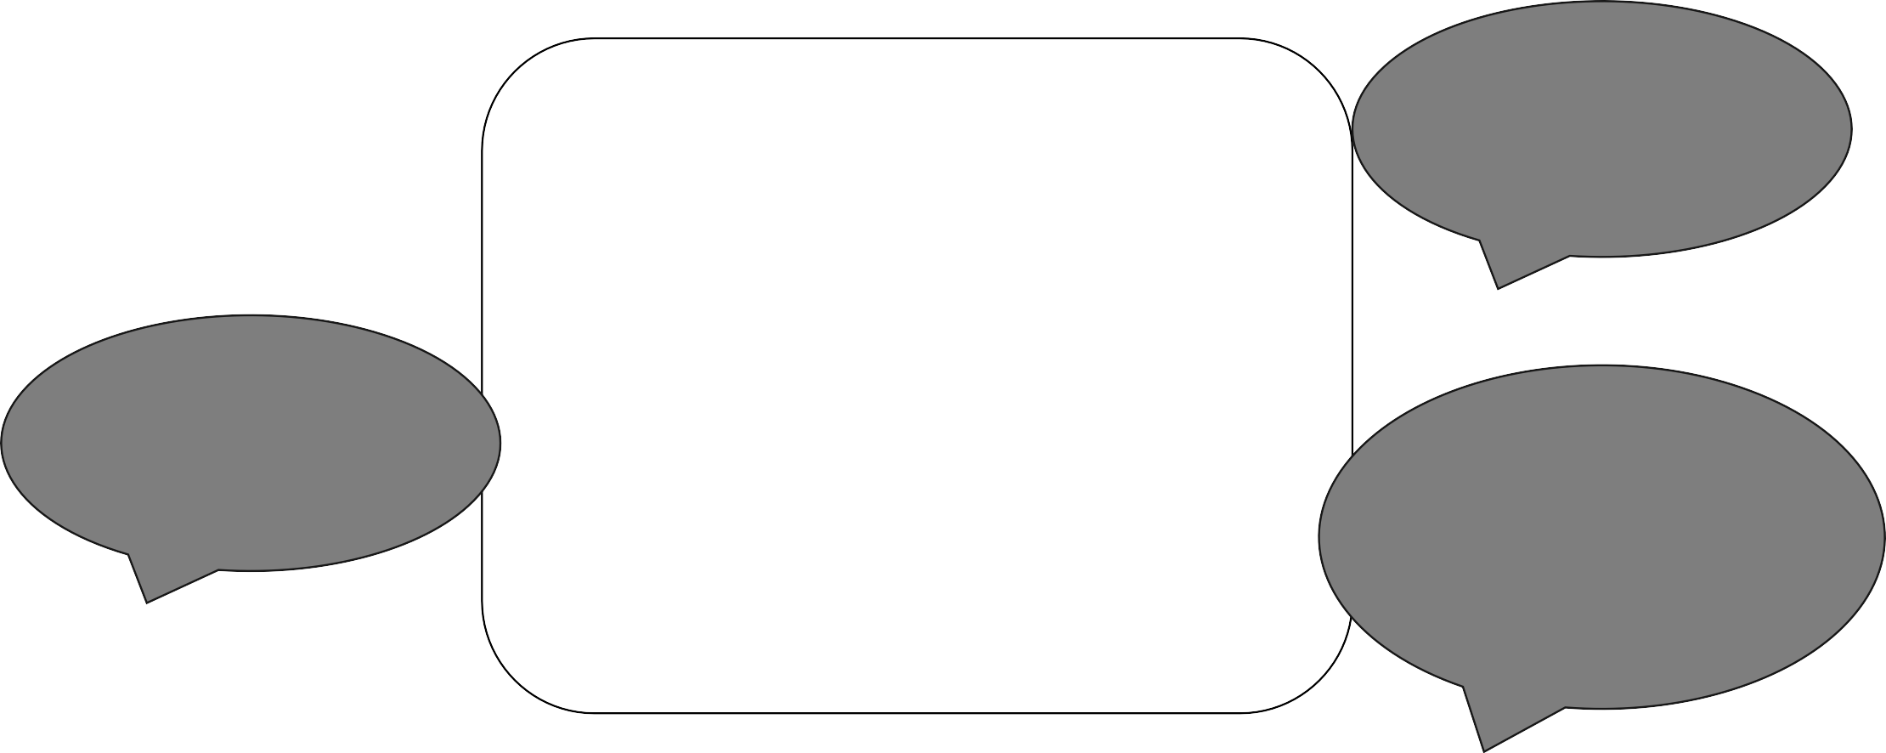
Call by reference
In call by reference method in place of calling a value to the function being called , a reference to the original variable is passed .i.e the same variable value can be accessed by any of the two names.
In function call We write reference variable for formal arguments
add(a,b);
}
void add(int &x,int &y);
{
--------;
}
No need for return statement
&X,&Y will be the reference variable for a and b. if we change X and Y, Value of a and b are changed accordingly

Slide 27
swap(a,b); cout<<“after swaping”; cout<<“A”<<a; cout<<“B”<<b; getch();
Program to illustrate call by reference
#include<iostream.h> #include<conio.h> void swap(int &,int &); int main()
{
int a,b;
}
void swap(int &X,&Y)
{
int temp; temp=X;
X=Y;
Y=X;
}
cout<<“enter the values of a and b”; cin>>a>>b;
cout<<“before swaping”; cout<<“A”<<a; cout<<“B”<<b;

Slide 28
Recursion

Slide 29
Objectives
become familiar with the idea of recursion
learn to use recursion as a programming tool
become familiar with the binary search algorithm as an example of recursion
become familiar with the merge sort algorithm as an example of recursion

Slide 30
How do you look up a name in the phone book?

Slide 31
One Possible Way
Search:
middle page = (first page + last page)/2
Go to middle page;
If (name is on middle page)
done; //this is the base case
else if (name is alphabetically before middle page)
last page = middle page //redefine search area to front half
Search //same process on reduced number of pages
else //name must be after middle page
first page = middle page //redefine search area to back half
Search //same process on reduced number of pages

Slide 32
Overview
Recursion: a definition in terms of itself.
Recursion in algorithms:
Natural approach to some (not all) problems
A recursive algorithm uses itself to solve one or more smaller identical problems
Recursion in Java:
Recursive methods implement recursive algorithms
A recursive method includes a call to itself

Slide 33
Recursive Methods Must Eventually Terminate
A recursive method must have
at least one base, or stopping, case.
A base case does not execute a recursive call
stops the recursion
Each successive call to itself must be a "smaller version of itself”
an argument that describes a smaller problem
a base case is eventually reached

Slide 34
Factorial (N!)
N! = (N-1)! * N [for N > 1]
1! = 1
3!
= 2! * 3
= (1! * 2) * 3
= 1 * 2 * 3
Recursive design:
Decomposition: (N-1)!
Composition: * N
Base case: 1!

Slide 35
factorial Method
public static int factorial(int n)
{
int fact;
if (n > 1) // recursive case (decomposition)
fact = factorial(n – 1) * n; // composition
else // base case
fact = 1;
return fact;
}

Slide 36
Execution Trace (decomposition)
public static int factorial(int n)
{
int fact;
if (n > 1) // recursive case (decomposition)
fact = factorial(n – 1) * n; (composition)
else // base case
fact = 1;
return fact;
}
factorial(4)
factorial(3) 4
factorial(2) 3
factorial(1) 2

Slide 37
Improved factorial Method
public static int factorial(int n)
{
int fact=1; // base case value
if (n > 1) // recursive case (decomposition)
fact = factorial(n – 1) * n; // composition
// else do nothing; base case
return fact;
}

Slide 38
Fibonacci Numbers
The Nth Fibonacci number is the sum of the previous two Fibonacci numbers
0, 1, 1, 2, 3, 5, 8, 13, …
Recursive Design:
Decomposition & Composition
fibonacci(n) = fibonacci(n-1) + fibonacci(n-2)
Base case:
fibonacci(1) = 0
fibonacci(2) = 1

Slide 39
fibonacci Method
public static int fibonacci(int n)
{
int fib;
if (n > 2)
fib = fibonacci(n-1) + fibonacci(n-2);
else if (n == 2)
fib = 1;
else
fib = 0;
return fib;
}

